Slide 1
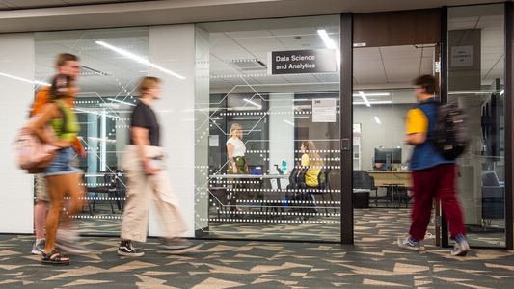
Supervised Machine Learning for Regression Tasks
Namig Abbasov
Data Science and Analytics

Slide 2
Machine Learning and Deep Learning Series
Open Lab 1: Introduction to Machine Learning and Deep Learning
Open Lab 2: Supervised Learning – Classification
Open Lab 3: Supervised Learning – Regression
Open Lab 4: Unsupervised Learning
Open Lab 5: Advanced ML – Ensemble Learning and Optimization
Open Lab 6: Deep Learning and Neural Networks
Open Lab 7: Transformer-based Models

Slide 3
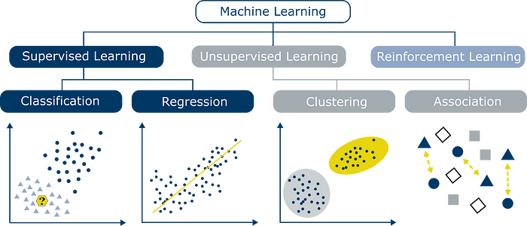

Slide 4
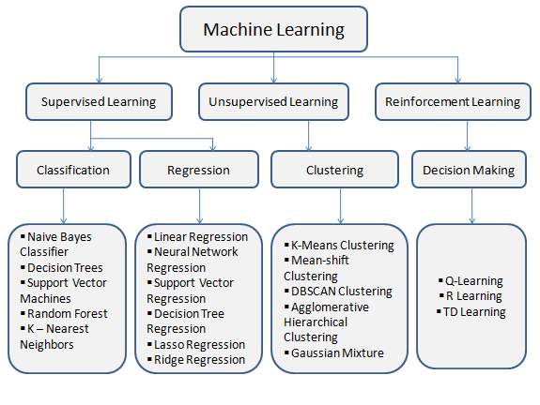
Algorithms Based on Types of ML

Slide 5
ML Regression Problems
Sales Forecasting
historical sales
Seasonality
holidays
economic trends
customer purchasing patterns
Price Optimization
Demand
competitor pricing
supply chain costs
customer behavior
Financial Risk Assessment
financial history
credit scores
employment status
debt-to-income ratio
Energy Consumption Forecasting
Car Prices
Year, milage, model,
House Prices
Location
square footage
number of bedrooms
crime rates
market trends
historical usage
weather conditions
industrial activity

Slide 6
Index | Square Feet | Rooms | Location | House Price | PredictedPrice | Error/Residuals | Absolute error | Squared Error
1 | 800 | 2 | 1 | 300k | 310k | -10k | 10k | 100k
2 | 1200 | 3 | 0 | 300k | 305k | -5k | 5k | 25k
3 | 1202 | 3 | 0 | 320k | 325k | -5k | 5k | 25k
4 | 450 | 1 | 0 | 200k | 205k | -5k | 5k | 25k
5 | 1760 | 5 | 1 | 1m | 995k | +5k | 5k | 25k
6 | 1600 | 4 | 1 | 750k | 745k | +5k | 5k | 25k
7 | 1250 | 3 | 0 | 505k | 500k | +5k | 5k | 25k
8 | 1200 | 2 | 1 | 240k | 230k | +10k | 10k | 100k
Total Sum of Squares (TSS) Variance Standard Deviation |  |  |  | 563,996,875,000 80,570,982,142.9 265517.6
Sum of Errors |  |  |  |  |  | 0
Mean Absolute Error(MAE) |  |  |  |  |  |  | 6,250
Sum of Squared Errors (SSE) |  |  |  |  |  |  |  | 350,000
Mean Squared Error (MSE) |  |  |  |  |  |  |  | 43,750
Root Mean Squared Error (RMSE) |  |  |  |  |  |  |  | 6,614

Slide 7
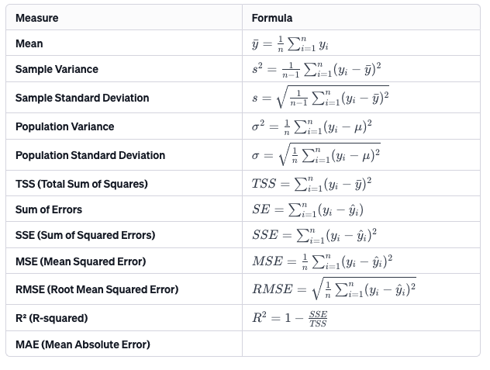


Slide 8
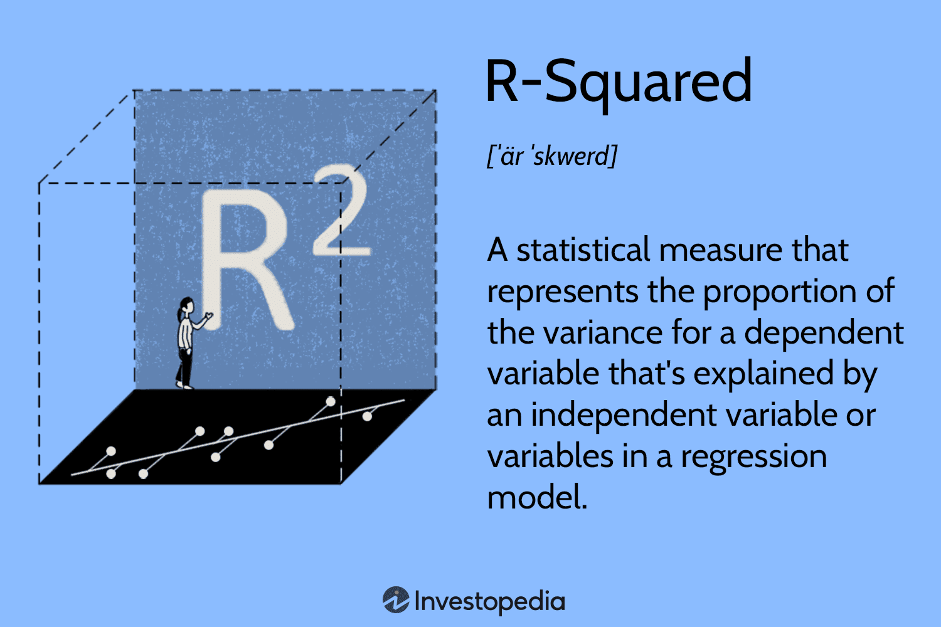

Slide 9
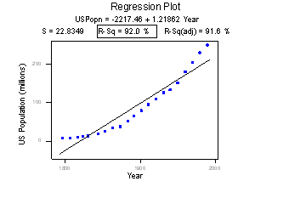
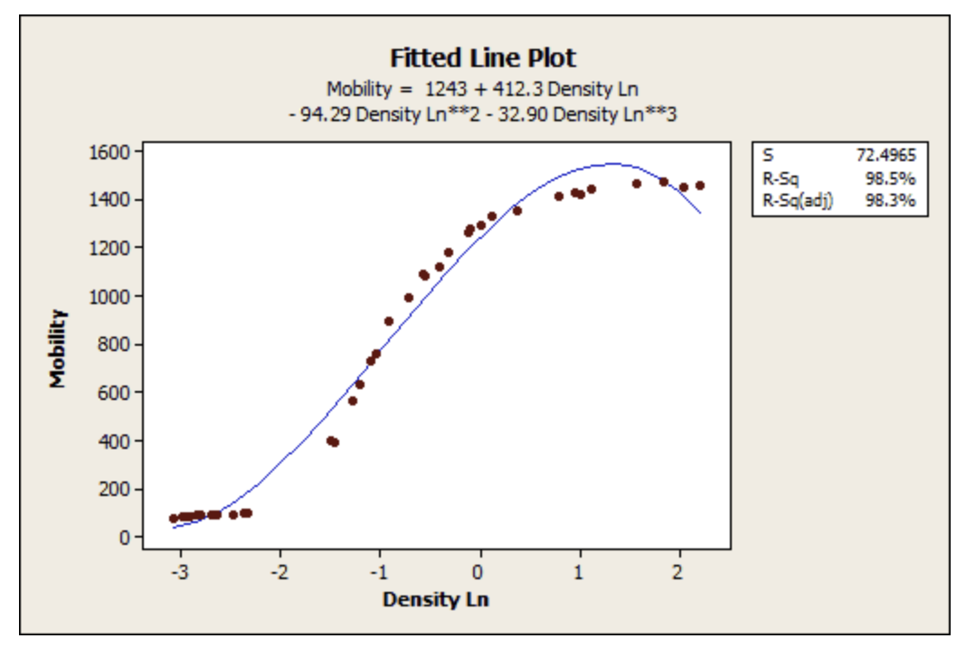
ARE LOW R-SQUARED VALUES INHERENTLY BAD? ARE HIGH R-SQUARED VALUES INHERENTLY GOOD?

Slide 10
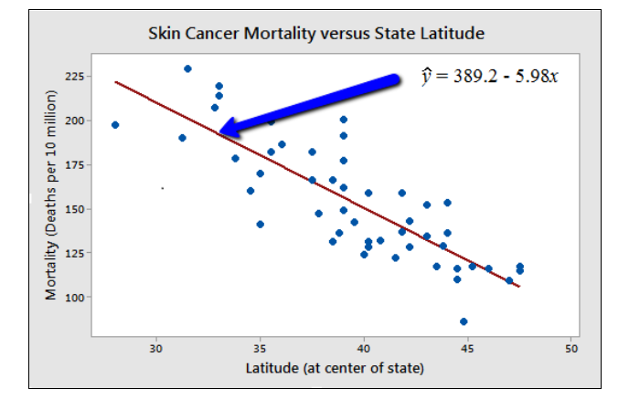
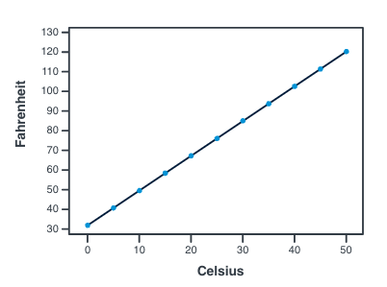
Where Do Errors Come from? Nature and Social World
Deterministic (or Functional) Relationships
Statistical Relationship
Ohm’s Law: I = V/r, where V = voltage applied, r = resistance, and I = current.
Hooke’s Law: Y = α + βX, where Y = amount of stretch in a spring, and X = applied weight.

Slide 11
But How Do We Get House Price Prediction?
This is where ML algorithms for regression come in:
Linear Models
Simple Linear Regression
Multiple Linear Regression
Polynomial Regression
Regularization
Ridge Regression (L2 Regularization)
Lasso Regression (L1 Regularization)
Elastic Net Regression(L1 and L2)
Support Vector Regression (SVR)
K-Nearest Neighbors (KNN) Regression
Neural Networks
Decision Tree Regression
Random Forest Regression
Gradient Boosting Machines (GBM)
XGBoost
LightGBM
CatBoost

Slide 12
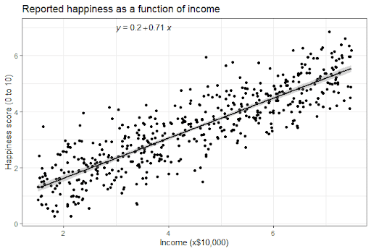
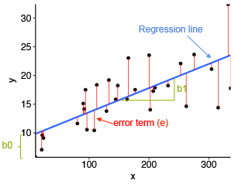
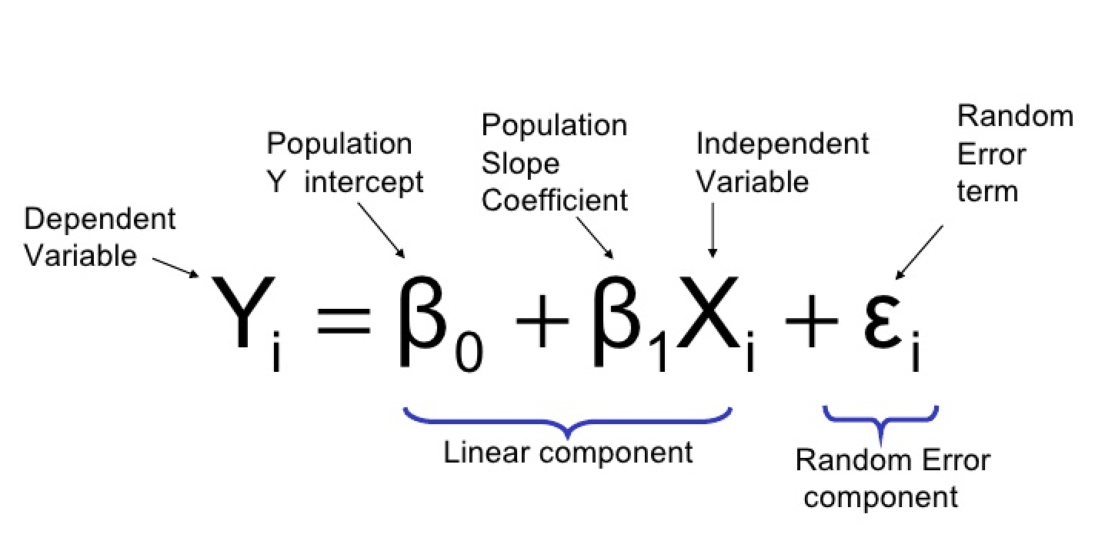
Simple Linear Regression

Slide 13
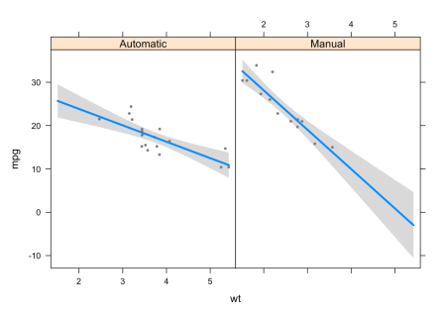
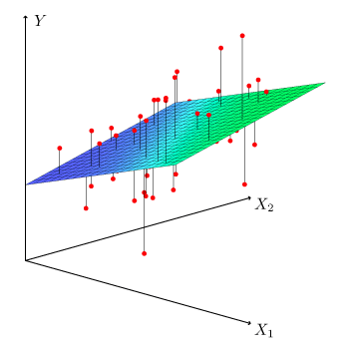
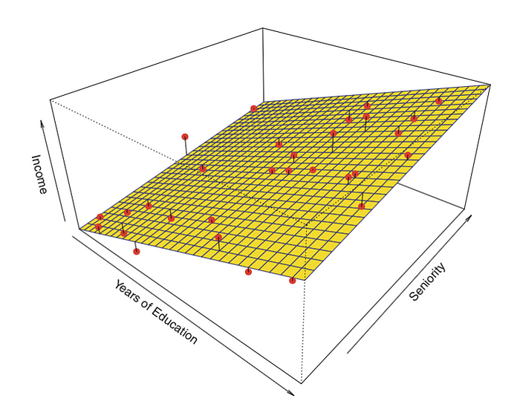
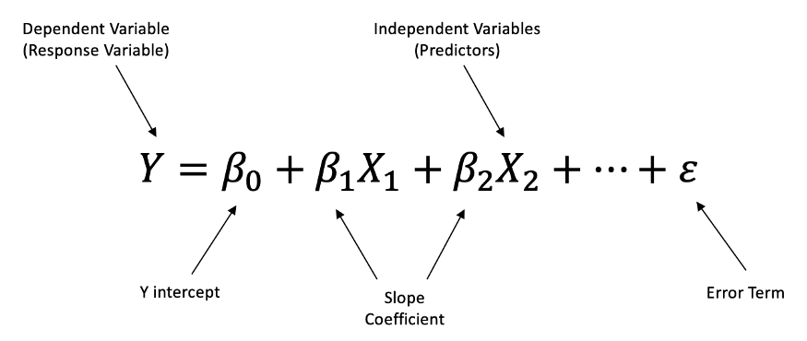
Multiple Linear Regression

Slide 14

Linear Regression Assumptions
Assumption 1: Linearity
Assumption 2: Independence of errors
Assumption 3: Normality of errors
Assumption 4: Equal Variances

Slide 15
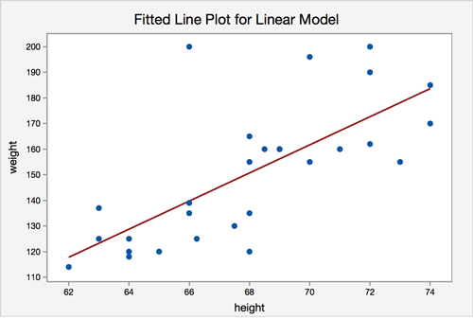
Linear Regression Assumptions: Linearity

Slide 16
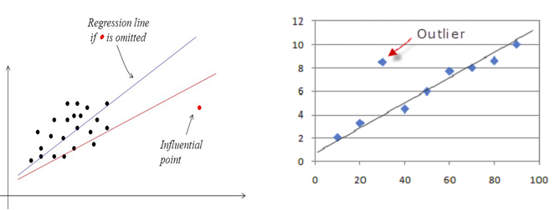

Slide 17
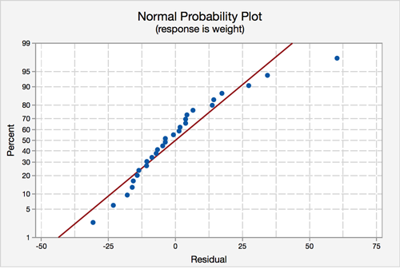
Linear Regression Assumptions: Normality of errors

Slide 18
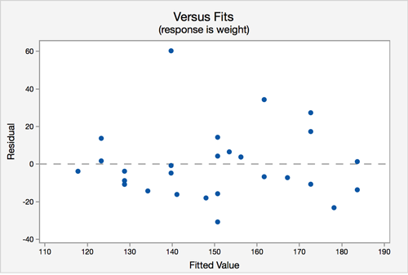
Linear Regression Assumptions:Equal Variances

Slide 19
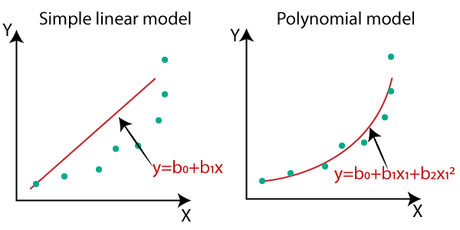

Polynomial Regression

Slide 20
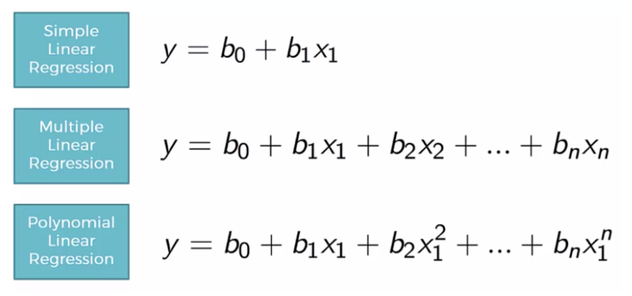
Is Polynomial Regression Really Linear?
“Although this model allows for a nonlinear relationship between Y and X, polynomial regression is still considered linear regression since it is linear in the regression coefficients, β1,β2,...,βh!”

Slide 21
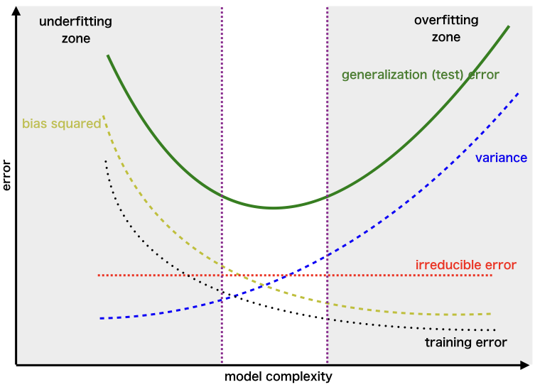
But Adding Too Many Polynomials Cause Overfitting? Trade Off Between Bias and Variance: Fundamental Problem in Machine Learning

Slide 22
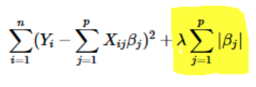

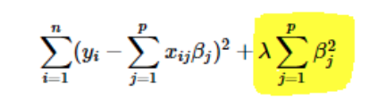

Regularization is One Solution to Overfitting!
LASSO Regression
Ridge Regression
Elastic Net

Slide 23
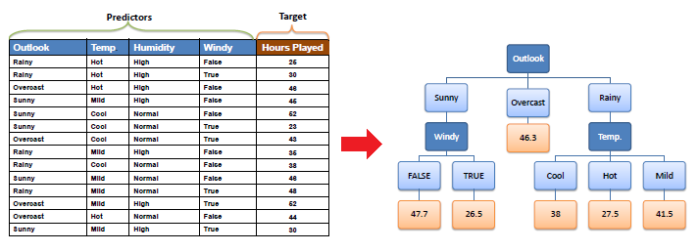
Decision Tree Regression

Slide 24
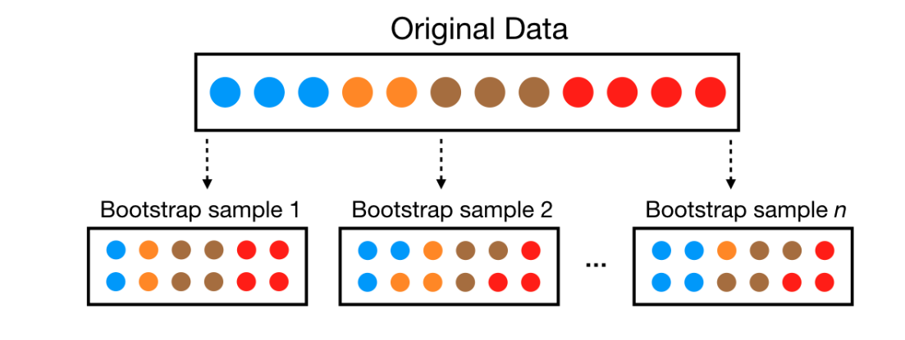
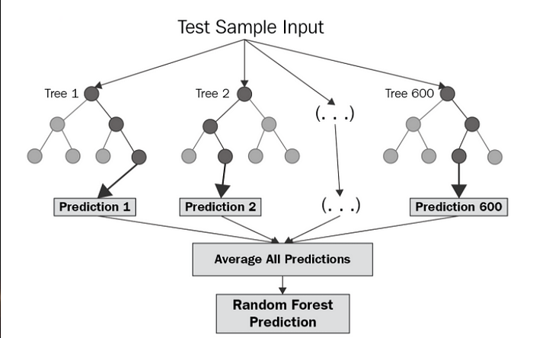
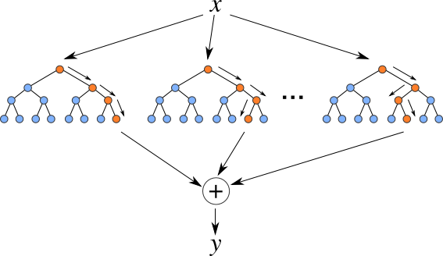
Random Forest Regression

Slide 25
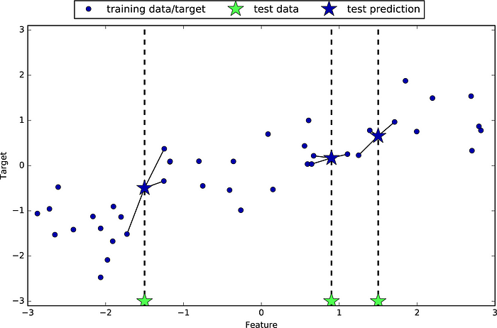
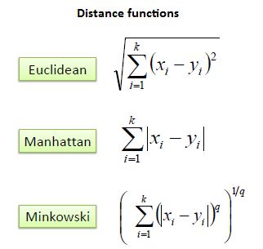
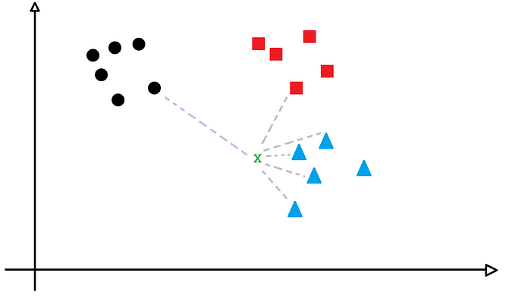
KNN Regression

Slide 26
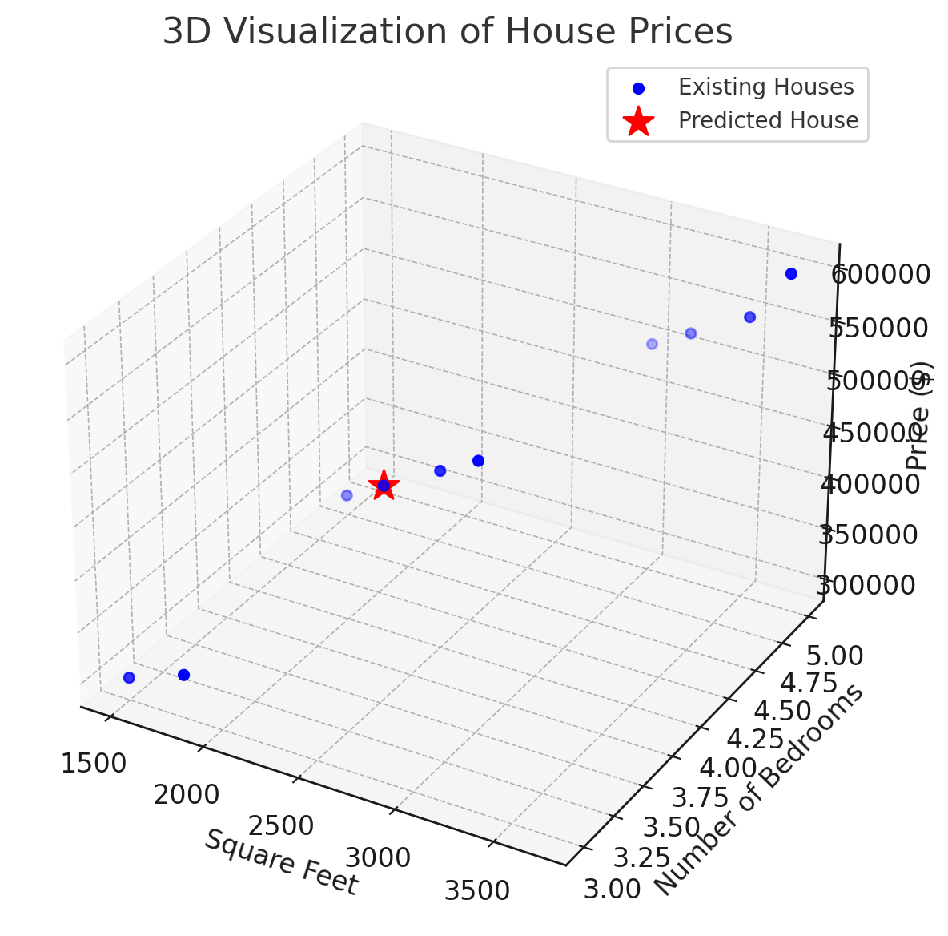
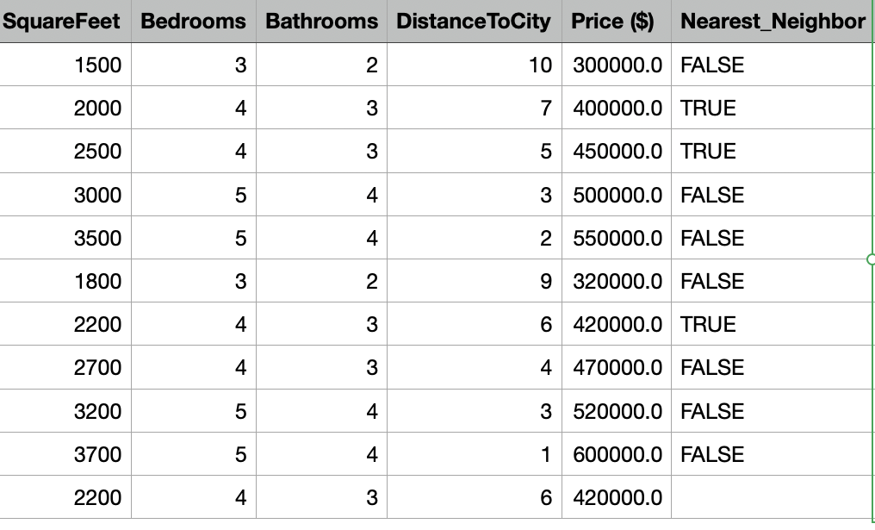
House Prices with KNN

Slide 27
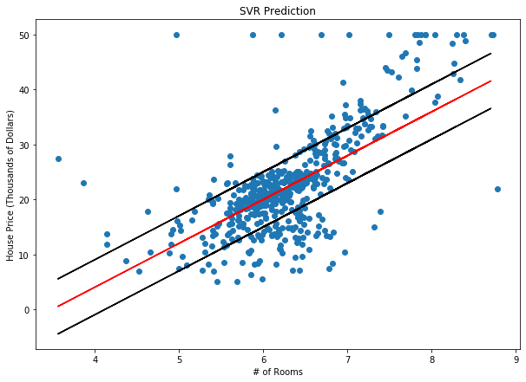
Support Vector Regression

Slide 28
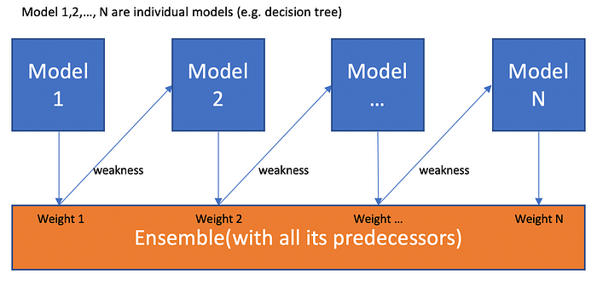
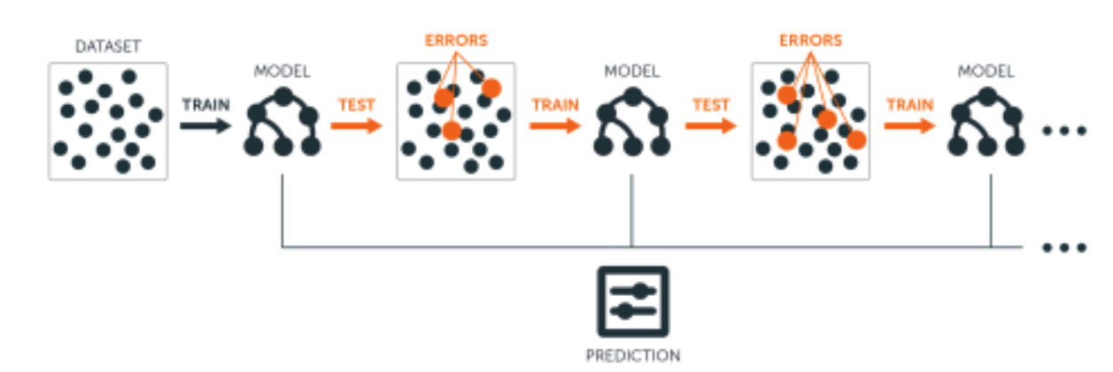
Boosting in ML

